Slide 1
Distributed Multi-Robot Task Management
Yikang Gui
Prof. Ramviyas

Slide 2
Introduction
In this project, we are aiming to achieve high performance and efficiency in treasure hunting by multiple homogeneous robots.
Additionally, we are dealing with distributed multi-robot system instead of centralized multi-robot system.
Therefore, we must find a algorithm to deal with the communication between every pair of connected robots.

Slide 3
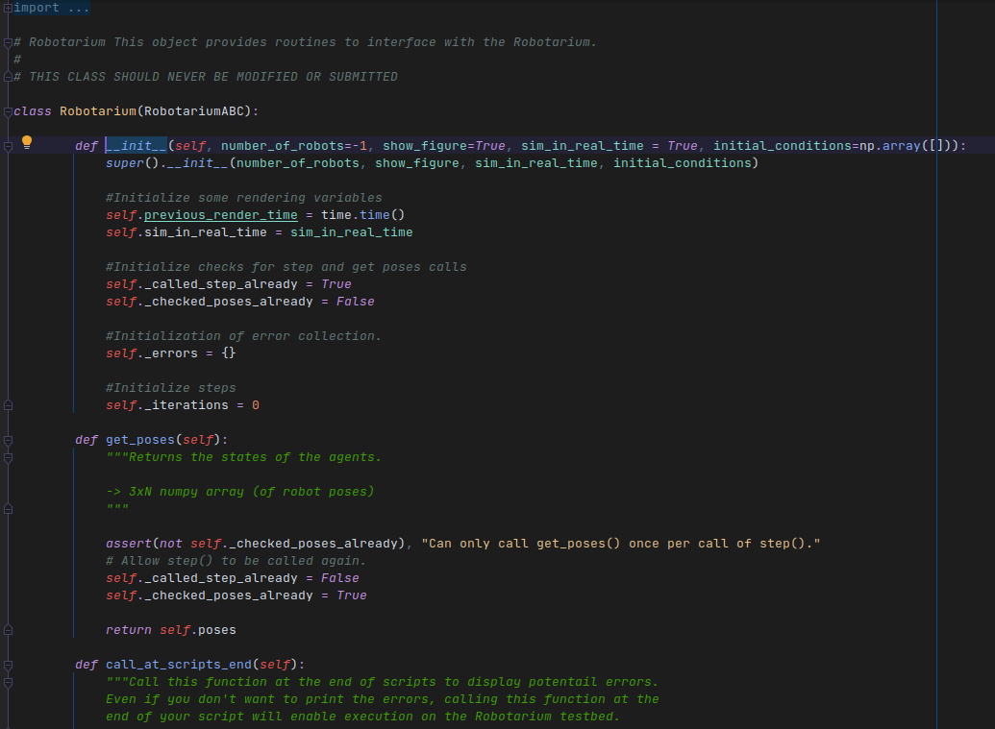
Robotarium
Simulator: Robotarium in Python
Two key concerns:
Flexibility
Safety
Notes:
The Robotarium addressed the two key concerns of flexibility and safety. Unlike other remotely accessible testbeds, the Robotarium makes use of formal methods to ensure the safety of its physical assets and the avoidance of damage to the robots. These methods guarantee collision avoidance in a minimally invasive manner without overly constraining the type of control algorithms that can be executed on the Robotarium.

Slide 4
Related Work
Yang, Qin, and Ramviyas Parasuraman. "Hierarchical needs based self-adaptive framework for cooperative multi-robot system." 2020 IEEE International Conference on Systems, Man, and Cybernetics (SMC). IEEE, 2020.
Introduce a novel SASS framework for cooperation heterogeneous multi-robot systems for dynamic task assignments and automated planning.
Combines robot perception, communication, planning and execution in MRS.
Proposes Robot’s Needs Hierarchy to model the robot’s motivation
Provide several Atomic Operations to decompose the complex tasks into a series of simple sub-tasks.
Needs-based cooperation mechanism outperforms state-of-the-art methods in maximizing global team utility and reducing conflicts in planning and negotiation.
Notes:
In this paper, it introduces a novel SASS framework for cooperation heterogeneous multi-robot systems for dynamic task assignments and automated planning. It combines robot perception, communication, planning, and execution in MRS, which considers individual robot’s needs and action plans and emphasizes the complex relationships created through communication between the robots. Specifically, they proposed Robot’s Needs Hierarchy to model the robot’s motivation and offer a priority queue in a distributed Negotiation-Agreement Mechanism avoiding plan conflicts effectively. Then, they provide several Atomic Operations to decompose the complex tasks into a series of simple sub-tasks. The proposed solution is evaluated through extensive simulations under different static and dynamic task scenarios. The experimental analysis showed that the needs-based cooperation mechanism outperformed state-of-the-art methods in maximizing global team utility and reducing conflicts in planning and negotiation.

Slide 5
Related Work
Djenadi, Ali, and Boubekeur Mendil. "Energy-aware task allocation strategy for multi robot system." International Journal of Modelling and Simulation (2021): 1-15.
This paper presents a distributed energy management task allocation strategy, D-ILS(Distributed-Iterative Local Search) , for multi-robot systems involved in goods transportation.
Address a task allocation strategy that maximizes productivity and minimizes the energy consumption.
A designed Iterative Local Search (ILS) metaheuristic and a novel heuristic-based utility function are used to solve the multi-robot task allocation problem.
Each individual robot uses the designed ILS to efficiently exploit the search in a local region.
The approach takes advantage of the multi-agent aspect of the multi-robot system to better explore the search space.
Notes:
This paper presents a distributed energy management task allocation strategy, D-ILS, for multi-robot systems involved in goods transportation. It addresses a task allocation strategy that maximizes productivity and minimizes the energy consumption by considering the energy management in the task allocation. For this purpose, a designed Iterative Local Search (ILS) metaheuristic and a novel heuristic-based utility function are used to solve the multi-robot task allocation problem. In the proposed D-ILS strategy, each individual robot uses the designed ILS to efficiently exploit the search in a local region. The approach takes advantage of the multi-agent aspect of the multi-robot system to better explore the search space.

Slide 6
Related Work
Fouad, Hassan, and Giovanni Beltrame. "Energy Autonomy for Resource-Constrained Multi Robot Missions." 2020 IEEE/RSJ International Conference on Intelligent Robots and Systems (IROS). IEEE, 2020.
Present a control barrier function (CBF) based framework for long term autonomy of multi robot systems with limited charging resources.
Introduce a CBF based framework to achieve the necessary coordination for sharing the charging station
Notes:
In this paper they present a control barrier function (CBF) based framework for long term autonomy of multi robot systems with limited charging resources. They started by highlighting some tracking properties of the energy persistence CBF and then they introduced a CBF based framework to achieve the necessary coordination for sharing the charging station. They investigate the system capacity in terms of the relation between feasible requirements of charging cycles and individual robot properties. They show simulation results, using a physics-based simulator and real robot experiments to demonstrate the effectiveness of the proposed approach.

Slide 7
Environment
Settings:
N=5 number of robots
T=5 fixed treasure locations
R=2 fixed recharger stations at top right and top left of the workspace
C=1 one fixed collection point at bottom left of the workspace
Starting position of the robots = random within the workspace
Distance clearance threshold = 0.1m (to decide if a robot has reached a location or not)
All distances are expressed in Euclidean norm and time is expressed as iterations.

Slide 8
Environment
Assumption: Every task location has unlimited amount of treasure available. When a robot is at the task location, then it is assumed that the robot picked up the treasure (if it does not have one already). When a robot reached a collection point, then it is assumed that it dropped the treasure (if it already had one with it).
Definition of Task completion: A task is said to be complete when a robot reaches any of the task location, and it had then dropped that treasure at the collection point.

Slide 9
Environment
Energy model:
A robot will lose energy based on the following energy consumption model.
E(t) = E(t-1) – (alpha*1 + beta*dist_moved_from_previous_iteration + gamma*IsTreasurePickedUp)
A robot will gain energy if it is at the recharging station with the following model:
E(t) = E(t-1) + delta*1
Use the following values: alpha = 0.01, beta=0.1, gamma=0.02, delta =0.1

Slide 10
Algorithm - Distributed Task Management
Every robot will maintain a task schedule including the information about itself and other robots.
Every robot will broadcast its task schedule to its connected neighbor.
When a robot receives other’s task schedule, it will compare other’s task table with its own task table.

Slide 11
Algorithm - Distributed Task Management
In the task schedule, each robot’s information is saved as a task receipt.
Here is the structure of task receipt:
Task receipt:
task type
task location
previous task location: optional
timestamp
robot id

Slide 12
Algorithm - Distributed Task Management
Here is an example of task schedule
If we have three robots working at Robotarium. The task schedule
robot 1:
robot 2:
robot 3:

Slide 13
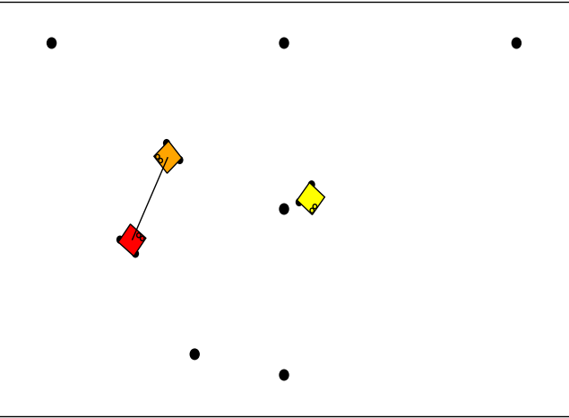
Algorithm - Distributed Task Management
The conflicts on the task schedule may happen due to the connectivity.

Slide 14
Algorithm - Distributed Task Management
As we can see from previous example, the conflicts happen.
To deal with the conflict, we will category the conflict into two sets.
The first set is the conflicts about GO_TO_PICK and GO_TO_COLLECTION. Because in this set, the task receipt with older timestamp has higher priority. We do not want robots continuing change their treasure tasks.
The second set is the rest conflicts. In this set, the task receipt with newer timestamp has higher priority. We want robots to update their task schedule according to others’ task schedule

Slide 15
Algorithm - Distributed Task Management
GO_TO_PICK | GO_TO_PICK | older
GO_TO_COLLECTION | GO_TO_PICK | older
GO_TO_PICK | GO_TO_COLLECTION | older
GO_TO_COLLECTION | GO_TO_COLLECTION | newer
GO_TO_PICK | IDLE | newer
GO_TO_COLLECTION | IDLE | newer
... | ...

Slide 16
Demo

